Slide 1
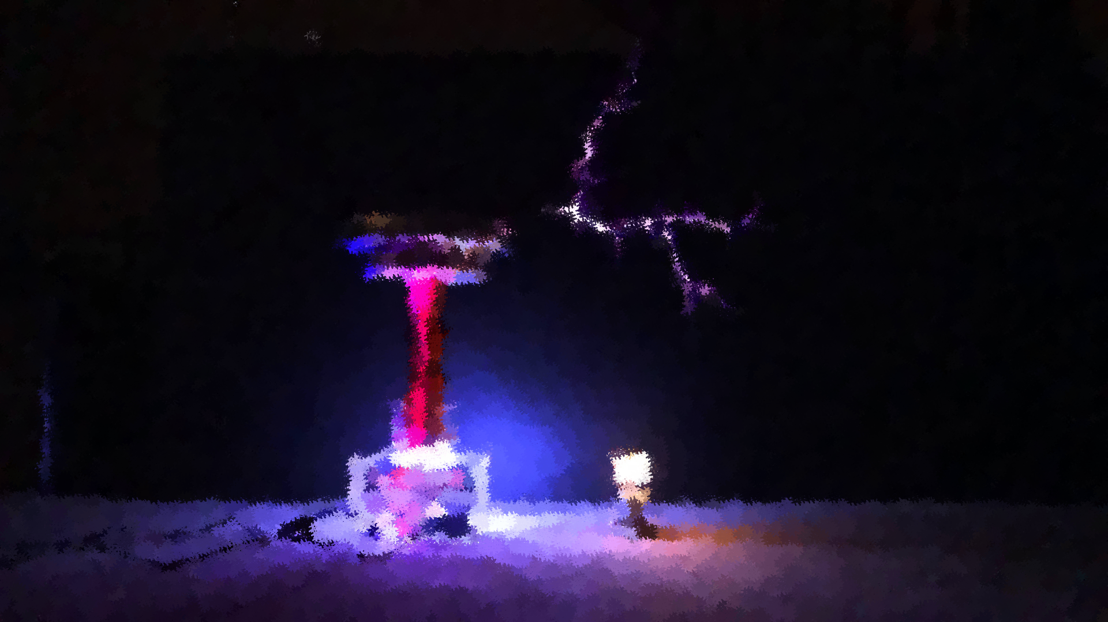
Wireless power transmission using tesla coil
Group No: 04
Student Id:
1906087 1906091
1906088 1906092
1906089 1906093
1906090
An Energy Conversion Laboratory Project
EEE 206
Supervised By:
Sadman Sakib Ahbab
Lecturer,EEE,BUET
Bejoy Sikder
Lecturer,EEE,BUET

Slide 2
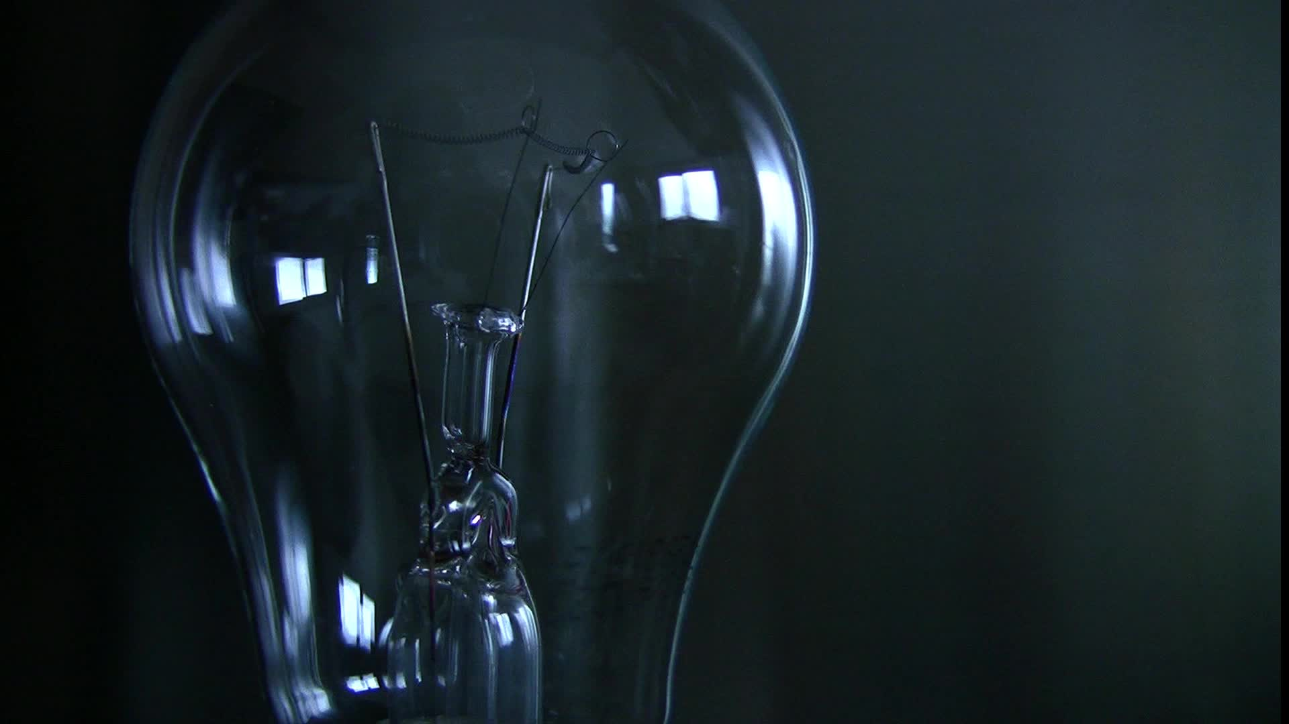
Expected Outcome
To Light a fluorescent bulb without any physical connection with the power source

Slide 3
About Slayer Exciter Circuit?
It is mainly an oscillator circuit with a step-up transformer at the collector of the transistor.
It creates an oscillating current from a DC power source through the primary winding.

Slide 4

More Information about Tesla Coil
Tesla coil is an electrical resonant transformer circuit designed by inventor Nikola Tesla in 1891. It is used to produce high-voltage, low-current, high frequency alternating-current electricity.
The power of the Tesla coil lies in a process called electromagnetic induction. A changing magnetic field creates an electric potential that compels current to flow. Conversely, flowing electric current generates a magnetic field.

Slide 5
Equipment's & Cost Analysis
Parts Used In This Project:
Transformer 220v-12Vx2(Center tapped)*-160 Taka
4pcs Diode-1n4007-10 Taka
1pcs Capacitor-25V 220uF-15 Taka
1pcs Tip41c Mosfet-20 Taka
1pcs 10k Resistor- 1 Taka
1pcs Heat Shrink- 10 Taka
1pcs(For the Mosfet) Cooling Fan- 100 Taka
1pcs(non polar-CL21 225k 400v) Capacitor -70 Tk
Wire-44awg(For the primary winding) wire-26awg(for the secondary winding) -300 Taka
Plastic Tube-(For the core of the secondary winding)-40 Taka

Slide 6
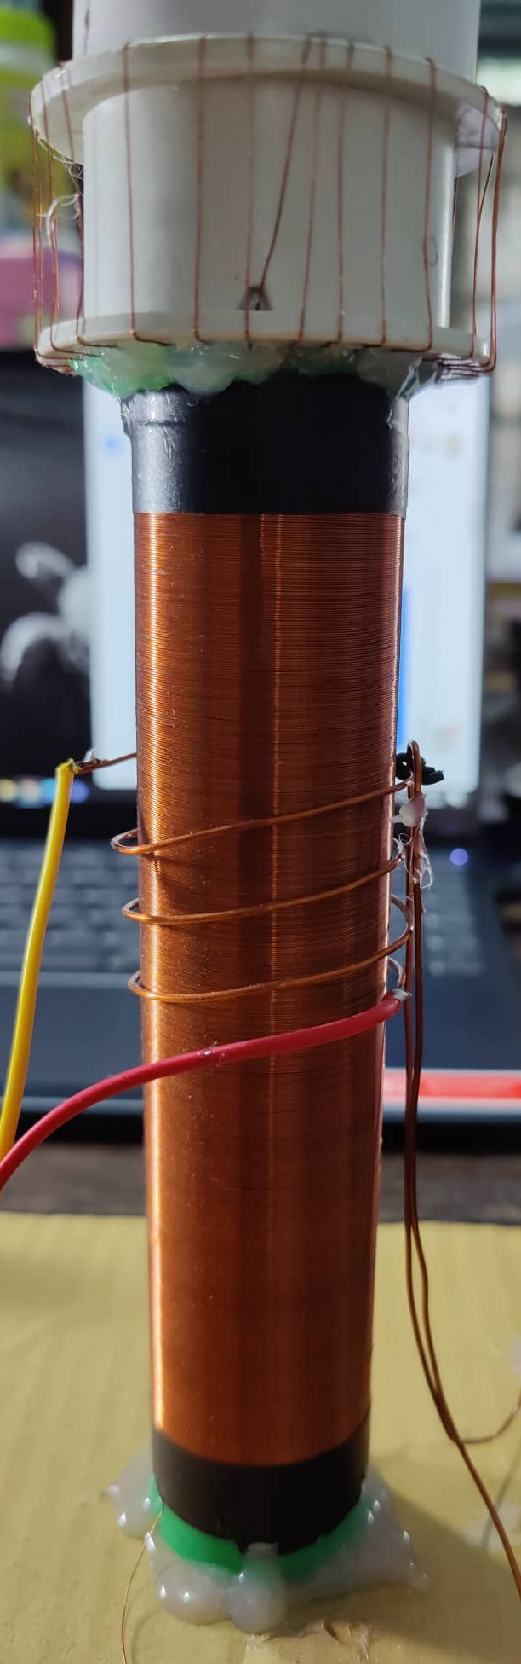
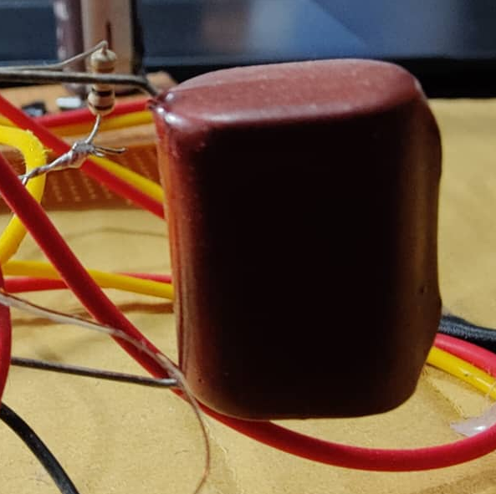
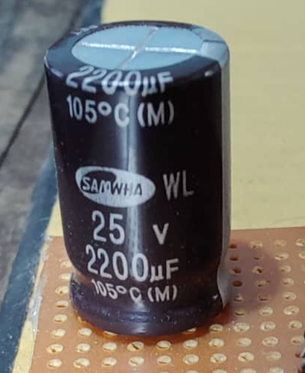
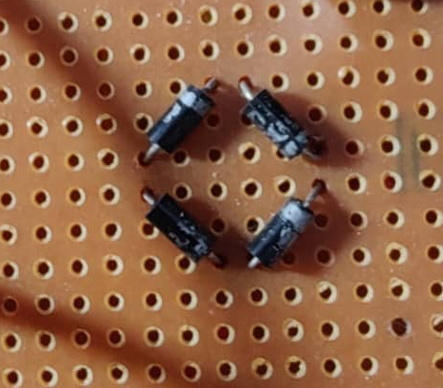
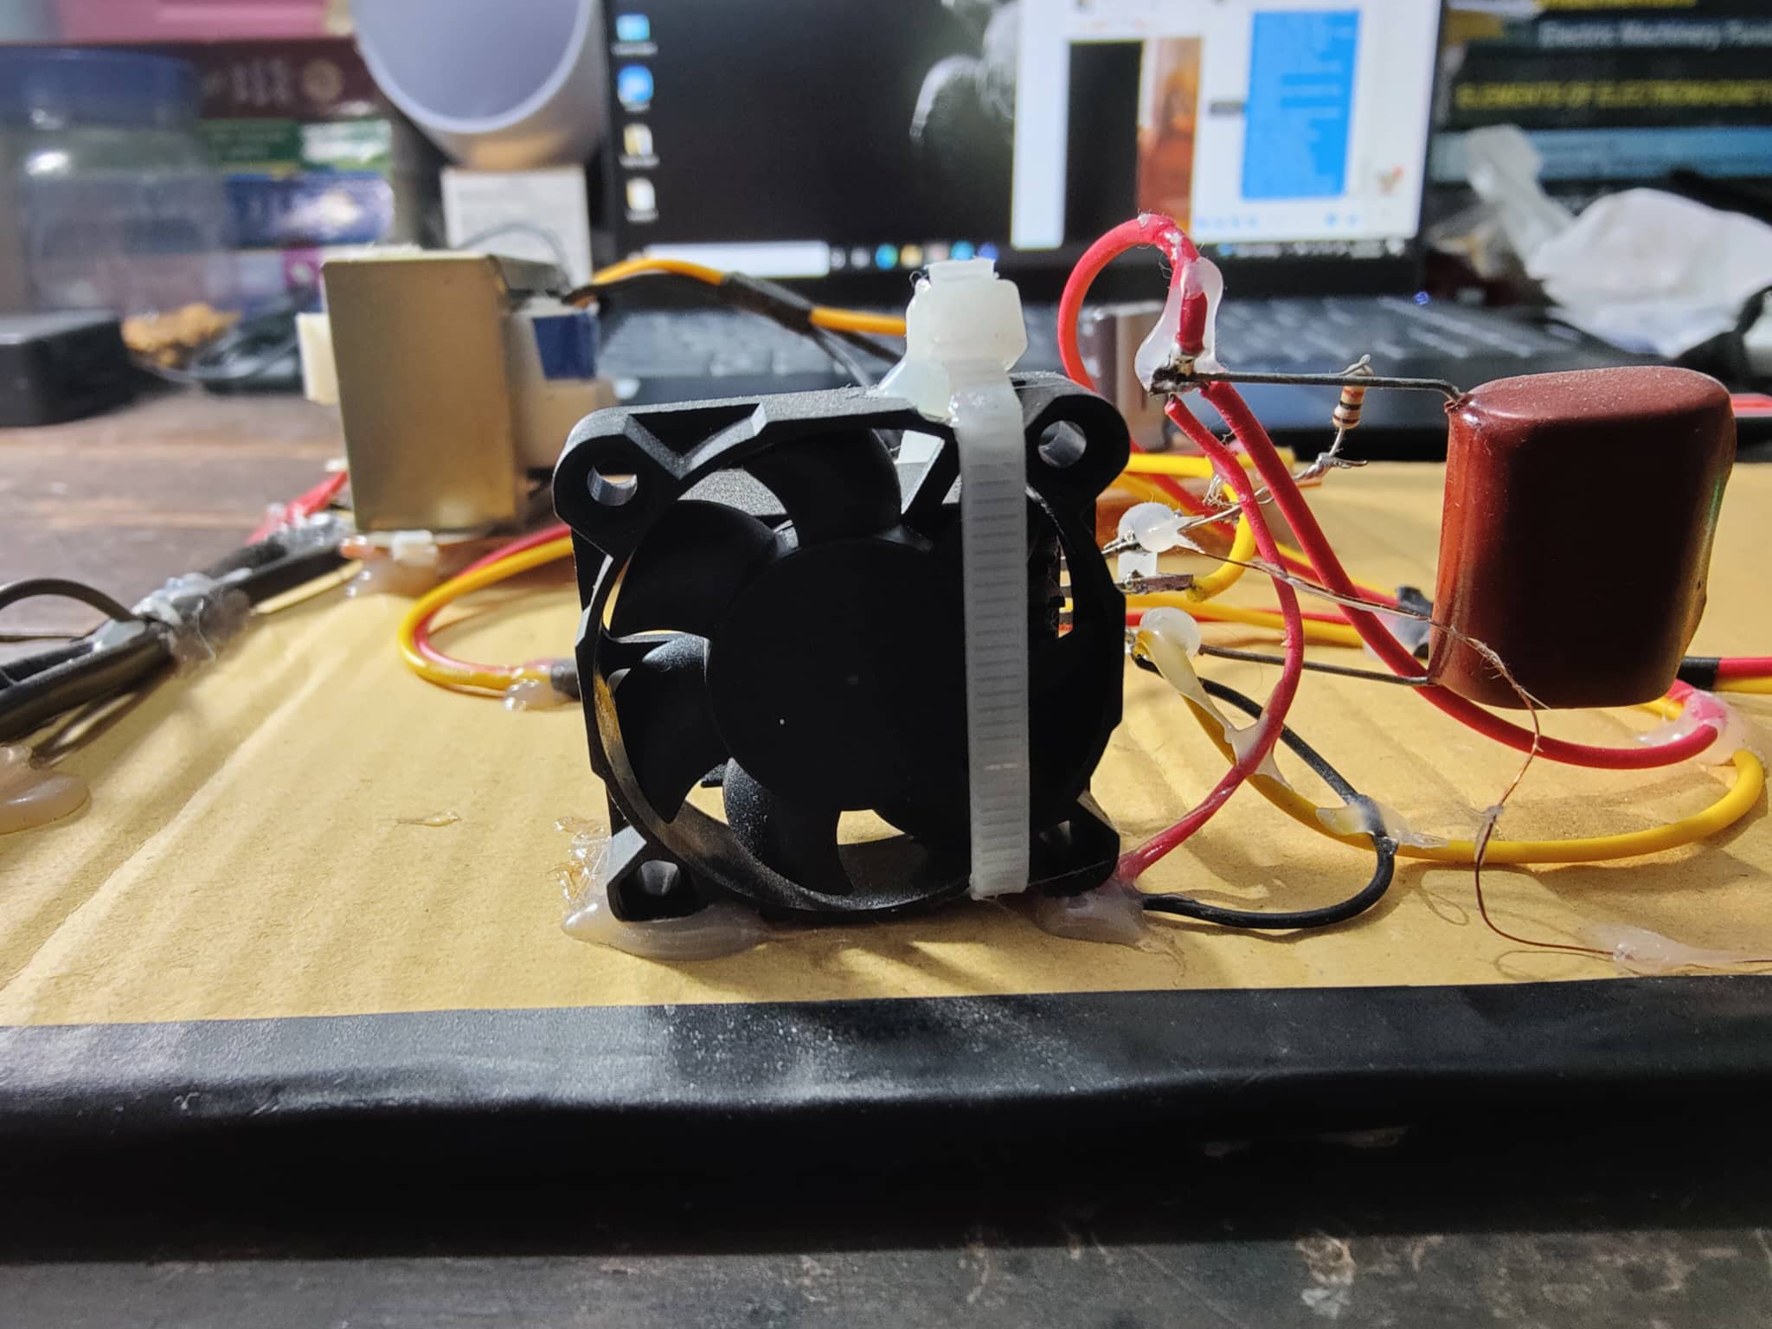
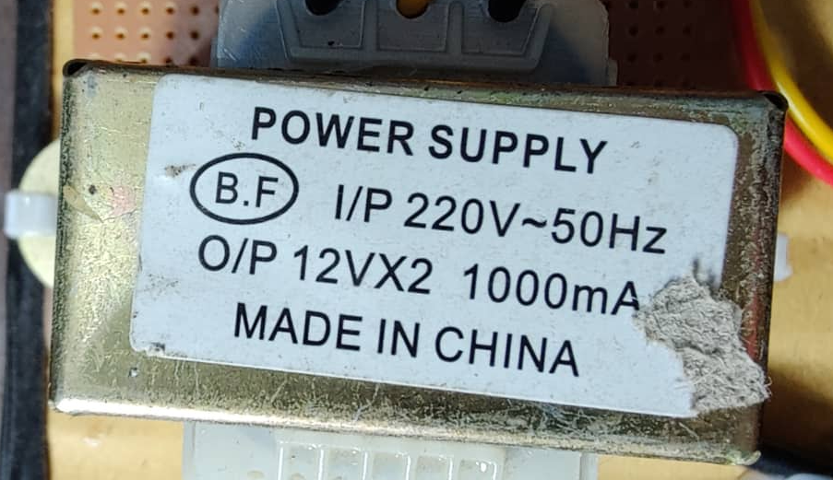
Capacitor(Non-Polar)
Capacitor(Polar)
Wire And Plastic Tube
Diode
Transformer
Cooling Fan

Slide 7
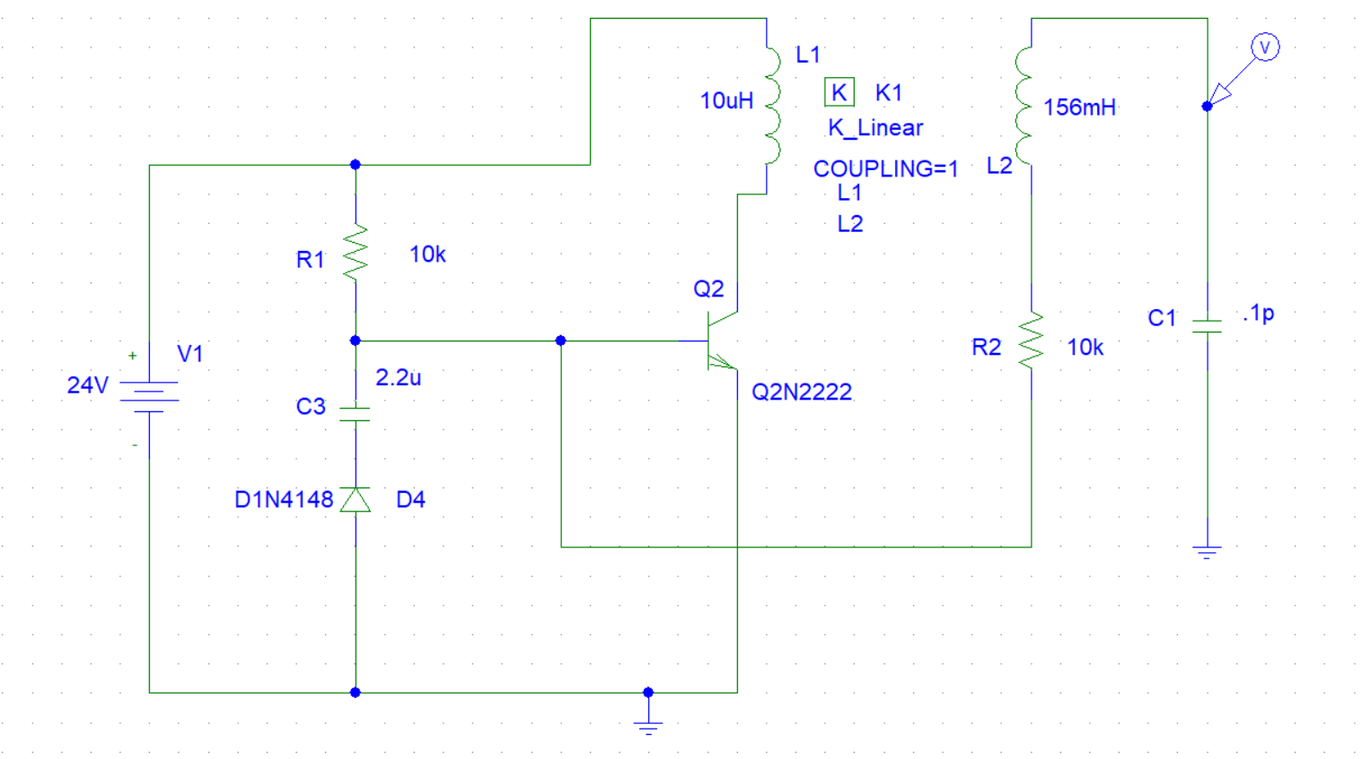
Circuit

Slide 8

Procedure
Turning the circuit on,
The resistor drives the base of the transistor.
The transistor turns on and drives current into the primary coil of the transformer.
The created magnetic field drives the secondary of the transformer.
The secondary voltage wants to grow larger but the parasitic capacitance between the secondary and ground halts that. As a result, voltage on the other end of the transformer goes down, pulling the base voltage of the transistor to low.

Slide 9
The capacitor prevents the base voltage from going below ground. This in return pushes the output end of the secondary high.
The transistor turns off and so the magnetic field starts to reduce.
The base voltage rises again, the transistor turns on and the cycle repeats.

Slide 10
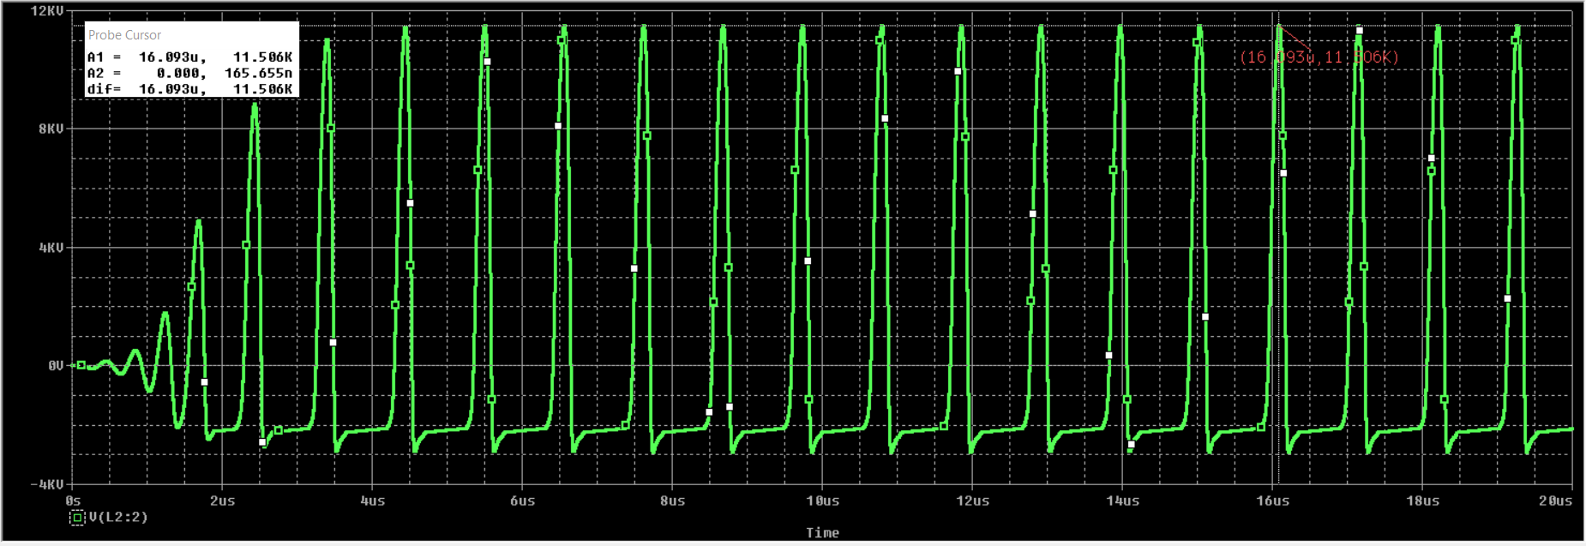
Simulation

Slide 11
Application
Tesla coil can used for transmitting power from one source to more than one device at a time.
High vacuum system or arc lighter
Vacuum system leak detector
Equal distribution of voltages can be ensured.
Almost harmless to devices.

Slide 12
Limitation
Tesla coil produce high voltage so it can be hazardous to human health.
If we increase the distance between the device and tesla coil the transmission gets low. So, we don’t get expected power.
The construction of the windings of tesla coil is much time consuming.

Slide 13
Future Improvements
Efficiency of the project can be further improved.
Limitation of distance in power transmission can be taken care.
Heat management of the equipment's can be improved.
Size of the device can be reduced by future research.

Slide 14

Thank you

